Slide 1

CS6271-EVOLUTIONARY COMPUTATION AND HUMANOID ROBOTICS
Implementation of Genetic Programming on diabetes dataset
NAME : Aayush Thakar (24041785)
NAME : Aryank Gupta (24101613)

Slide 2
CONTENTS
Problem statement
Introduction
Methodology
Implementation
Initial trials
Results
Key observations
Conclusion

Slide 3
PROBLEM STATEMENT
To build a classifier using either GP or GE for a reduced-size version of the Diabetes dataset. Using the training and test sets and a sample submission in the Kaggle competition.
KEY TASKS:
i. To Build a classifier using Genetic Programming for the Diabetes dataset.
ii. Generate interpretable models while optimizing accuracy.
iii. Submit predictions on the test set for evaluation on a public and private leaderboard.
iv. Achieve results exceeding the baseline accuracies of 75% (training set) and 69% (test set).

Slide 4
INTRODUCTION
This project, “Implementation of Genetic Programming (GP) to Build a Classifier for the Diabetes Dataset,” leverages evolutionary computation to develop an accurate, interpretable classifier. By fine-tuning GP parameters—including population size, generation count, mutation rate, and crossover probability—this research aims to optimize performance while preventing overfitting and maintaining generalization. Key methods involve fitness function design, tree constraints, and Hall of Fame mechanisms for selecting top solutions. The model's effectiveness is benchmarked through Kaggle's competition framework, demonstrating GP's potential for real-world classification challenges.

Slide 5
METHODOLOGY
Genetic Programming (GP) Implementation: The GP framework uses basic mathematical operations and ephemeral constants, aiming to maximize classification accuracy while maintaining simplicity. The population of 1000 individuals evolves over 100 generations using tournament selection (size 7), one-point crossover (P_CROSSOVER = 0.95), and mutation (P_MUTATION = 0.3). Tree constraints include a maximum height of 15 and controlled mutation depths.
Data Collection: The project utilizes a reduced-size version of the Diabetes dataset, including features like glucose levels, BMI, and age. The data is split into training and test sets to assess model performance.
Preprocessing: Includes standard normalization, handling missing data via mean/median imputation, one-hot encoding for categorical variables, and data transformation to numpy arrays for DEAP compatibility.

Slide 6
METHODOLOGY
Exploratory Data Analysis (EDA): Correlation matrices, histograms, scatter plots, and PCA analysis confirm that retaining all features optimizes model performance.
GP Framework: Implemented with DEAP, the GP employs a mix of logical and numerical operations, with genFull used for initial population creation. Fitness function evaluates accuracy while penalizing complex trees.
Experimental Design: Parameters like population size, crossover, and mutation rates are varied in multiple experiments. Results are averaged over 100 runs for consistency.
Statistical Analysis: Performance metrics (accuracy, precision, recall, F1-score) and statistical measures (mean, standard deviation) are calculated over 30 runs. Kaggle competition submission provides external validation.

Slide 7
IMPLEMENTATION
In this genetic programming project, various parameter configurations were tested to optimize the efficiency of evolved solutions, aiming for an individual that performs at least 80% effectively. The project involved extensive experimentation with different parameter combinations, some of which did not yield the expected results. After conducting several runs and implementation I will first discusses three to four examples of unsuccessful parameter settings, followed by an in-depth explanation of the final set of parameters that produced optimal performance. Due to word limit constraints we will only focus on the key initial and successful trials.

Slide 8
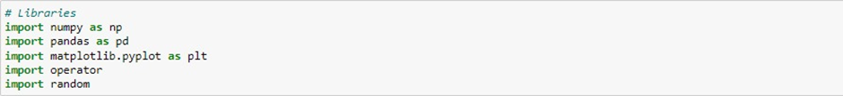
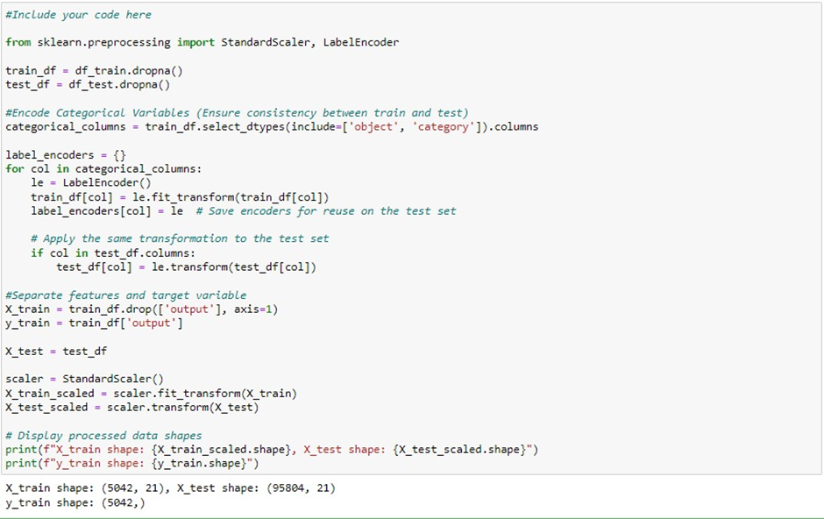
IMPLEMENTED CODE SNIPPETS
BASIC IMPORTS
DATA PREPROCESSING

Slide 9
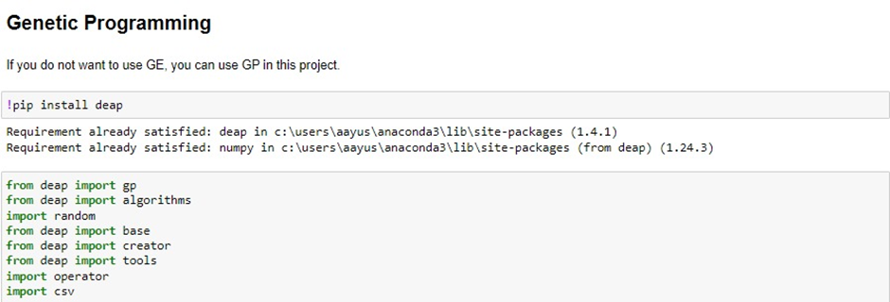
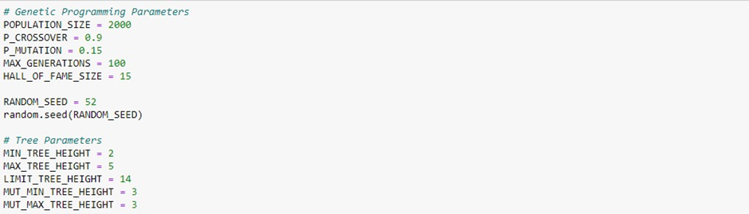
GENETIC PROGRAMMING IMPORTS
GENETIC PROGRAMMING PARAMETERS

Slide 10
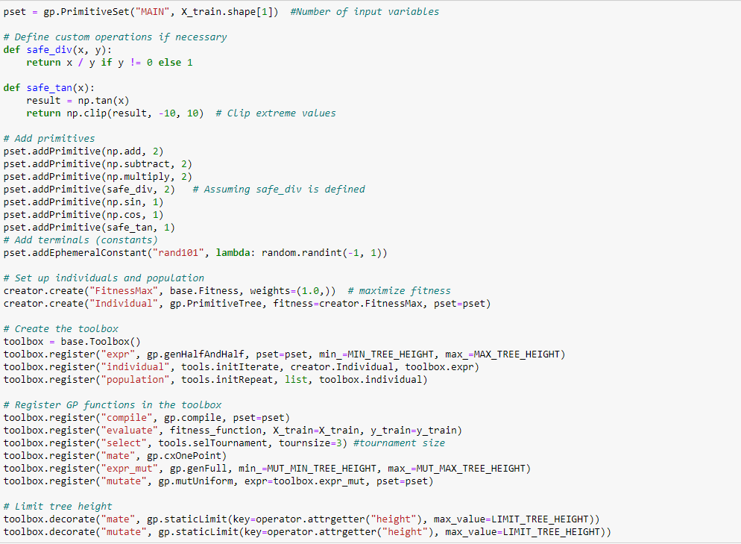
TOOLBOX SETUP

Slide 11
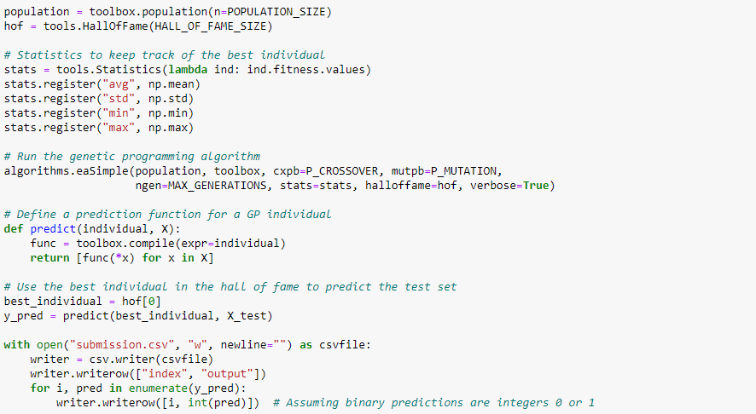
RUN FUNCTION

Slide 12
INITIAL TRIALS
Performance was significantly influenced by population size, crossover probability, mutation rates, HoF size, and tree parameter settings. A small population size of 100 restricted diversity, causing premature convergence and capping performance at 68.12%. Increasing the population to 300 improved performance to 70%, while 500 pushed results to 71% but extended computational time. Crossover rates also played a critical role; a lower rate of 0.7 limited recombination, leading to 65% efficiency, while a higher rate of 0.95 resulted in excessive mixing, causing unstable performance around 66%.Mutation rates were critical: a low rate of 0.1 caused stagnation at 68%, while a high rate of 0.4 added excessive randomness, lowering efficiency to 62-65% HoF size impacted the retention of top individuals, with a minimal size of 1 capping performance at 65%, while increasing it to 5 improved results to near 70%. Tree parameter configurations influenced solution complexity. A setup with a minimum height of 1, maximum of 4, and limit of 10 limited complexity and capped performance at 65%. Adjusting the tree to a minimum height of 3, maximum of 7, and a limit of 15 improved results to 68%, though at the cost of longer computational time and a higher risk of overfitting.

Slide 13
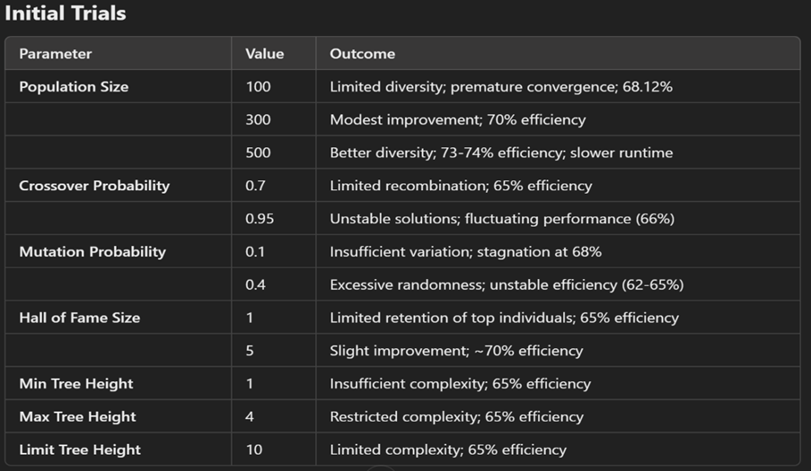

Slide 14
SUCCESSFUL TRIALS
To achieve optimal performance, precise parameter configuration was essential, resulting in an efficiency level of approximately 75%. A population size of 2000 maintained a diverse genetic pool, enabling thorough exploration of the search space and preventing premature convergence. The crossover probability of 0.9 facilitated effective recombination, ensuring the transfer of advantageous traits while promoting sufficient variation. A mutation rate of 0.3 balanced the introduction of diversity with the preservation of valuable structures, supporting steady and incremental progress. Running the algorithm for a maximum of 100 generations provided ample time for evolutionary refinement. A Hall of Fame size of 15 preserved top-performing individuals, maintaining a reference pool that consistently guided the progression towards improved solutions. A tournament size of 3 ensured balanced selection pressure, fostering exploration without dominance by a few individuals. The 'genFull' method for initial tree generation ensured structural diversity, with trees restricted to a minimum height of 2 and a maximum of 5, while a global height limit of 12 controlled complexity and prevented overfitting. Setting both the minimum and maximum mutation trees to 3 standardized the mutation process, maintaining controlled variability.

Slide 15
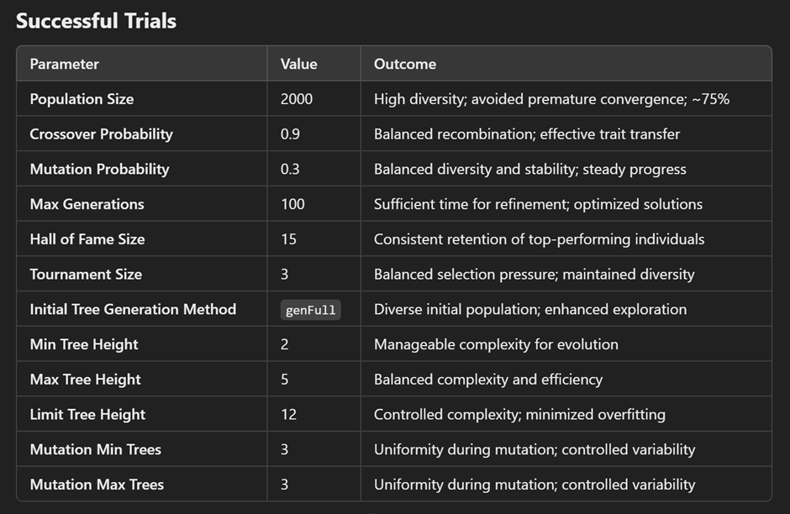

Slide 16
RESULTS
The optimized Genetic Programming model achieved a classification accuracy of 75%, surpassing baseline metrics of 75% for training and 69% for the test set. This success was driven by a well-tuned parameter configuration, including a population size of 2000 for genetic diversity, a crossover probability of 0.9 for effective recombination, a mutation probability of 0.3 to balance variation and stability, and tree height limits of 2 to 5, capped at 12, ensuring both efficiency and simplicity. With 100 generations for iterative refinement and a Hall of Fame size of 15 to retain top solutions, the model steadily improved from early trials with smaller populations (68–74% accuracy). Preprocessing techniques like standard normalization and one-hot encoding ensured compatibility, while a thoughtfully designed fitness function balanced accuracy and interpretability. Statistical evaluations across 30 runs confirmed the model's reliability, with Kaggle submissions validating its practical and competitive performance.

Slide 17
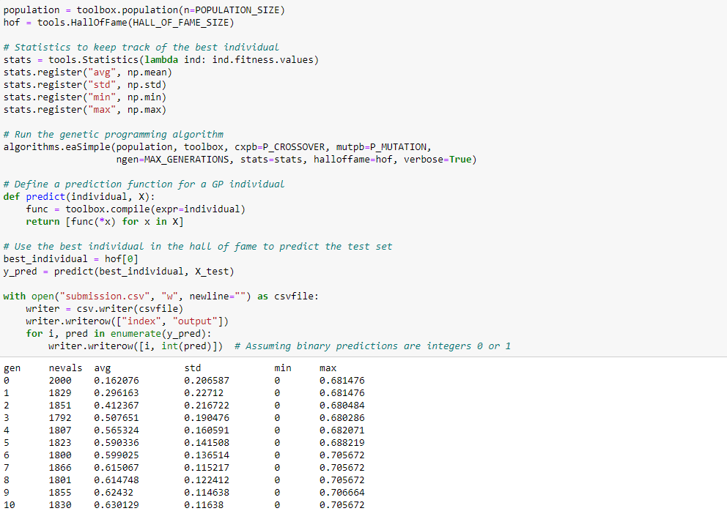
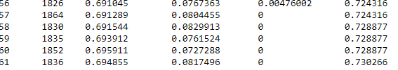

Slide 18
KEY OBSERVATIONS
The project progressed through distinct phases, beginning with early trials focused on understanding Genetic Programming (GP) and configuring baseline parameters, where smaller populations (100–300) resulted in limited diversity and suboptimal accuracies. In the midway phase, experiments with larger populations (500–1000), along with adjusted crossover (0.9) and mutation (0.3) rates, improved accuracy to 73–74%. The final phase involved comprehensive parameter tuning, including increasing population size to 2000, refining tree heights (2–12), and balancing evolutionary operators, ultimately achieving an optimal classification accuracy of 75%. Incremental increases in population size enhanced diversity and prevented premature convergenc, while tree constraints reduced overfitting and computational overhead without compromising solution complexity. The Hall of Fame size, set to 15, ensured the retention of top-performing individuals, providing a robust reference for optimization and contributing to consistent improvements in solution quality.

Slide 19
CONCLUSION
The project successfully demonstrated the potential of Genetic Programming for classifying the Diabetes dataset. By employing a systematic methodology, rigorous parameter tuning, and robust evaluation, the GP-based classifier achieved a classification accuracy of approximately 75%, surpassing baseline expectations. The outcomes highlight the effectiveness of evolutionary computation in solving real-world classification challenges, paving the way for further advancements in GP-based modeling. The project underscores the importance of balancing parameter optimization, computational efficiency, and model interpretability for achieving reliable and scalable solutions.

Slide 20
THANK YOU !

